Slide 1
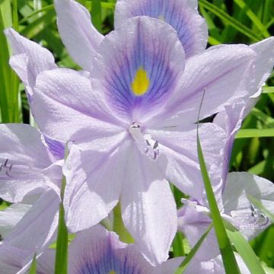
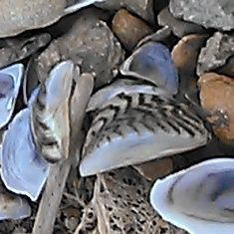
Ten Important Invasive Species
Notes:
Encyclopedia of Life. Available from http://www.eol.org. Accessed 23 Mar 2015.
Water Hyacinth: Encyclopedia of Life / Flora of Zimbabwe / © Mark Hyde, Bart Wursten, and Petra Ballings
Zebra Mussel: Encyclopedia of Life / iNaturalist.org / © Scott Ellsworth

Slide 2
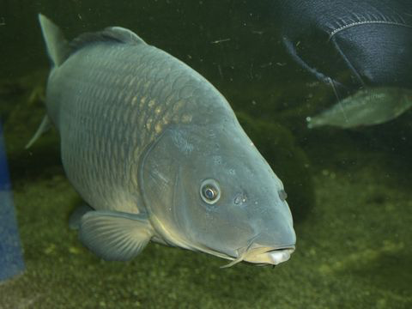
Asian Carp(s)
Impact on Native Species: They are large and have big appetites. They take food and habitat away from native fish
Interesting Fact: They change aquatic habitats by stirring up lake and river beds causing water to be murky instead of clear
Native Area: Eurasia
Where Found Now: North America and Europe
How Did They Get There: Brought over as food, pet trade, and sport fishing
Notes:
Encyclopedia of Life. Available from http://www.eol.org. Accessed 23 Mar 2015. Asian Carp: Encyclopedia Of Life / Biopix / Agua Silkeborg
"Asian Carp." UMESC. US Geological Survey, 14 Mar. 2014. Web. 26 Sept. 2015. <http://www.umesc.usgs.gov/invasive_species/asian_carp.html>.

Slide 3
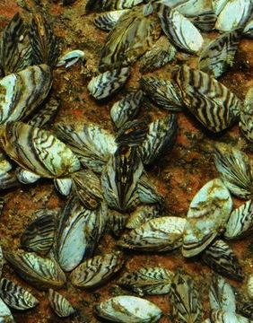
Zebra Mussel
Impact on Native Species: Plankton eaters -- population grows quickly and eats native populations food supply.
Interesting Fact: Zebra mussels cluster around pipes blocking them and disrupting water delivery to cities and factories
Native Area: Black, Caspian, Aral, and Azov Seas
Where Found Now: Russia, Europe, and North America
How Did They Get There: Brought over in ballast water of ships or attached to outside of boats
Notes:
Encyclopedia of Life. Available from http://www.eol.org. Accessed 23 Mar 2015. Zebra Mussel: Encyclopedia of Life /Biopix/Aqua Silkeborg\
Crozier, Danielle M., and Daniel P. Malloy. "Economic Impacts of Zebra Mussel Infestation." Economic Impacts of Zebra Mussel Infestation. US Army Corps of Engineers, n.d. Web. 24 Mar. 2015. <http://el.erdc.usace.army.mil/zebra/zmis/zmishelp/economic_impacts_of_zebra_mussel_infestation.htm>.

Slide 4
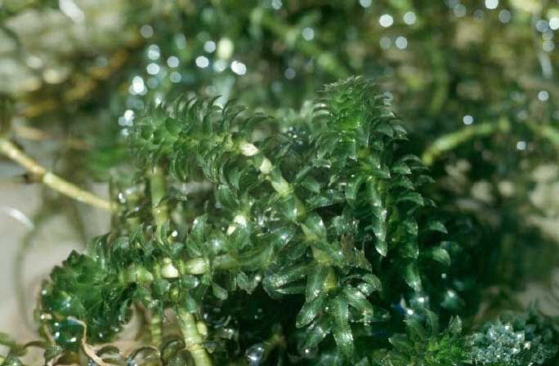
Hydrilla
Impact on Native Species: Crowds out native species; impedes irrigation and boating
Interesting Fact: When it invades an area, other plants are shaded out by hydrilla’s thick mats
Native Area: Eastern Hemisphere; U.S. strains originated in Asia
Where Found Now: Found primarily in two regions--southeastern and southwestern parts o the U.S.
How Did They Get There: Aquarium Trade
Notes:
Encyclopedia of Life. Available from http://www.eol.org. Accessed 23 Mar 2015. Hydrilla: Encyclopedia of Life / Wikimedia Commons / USGS
"Harmful Aquatic Hitchhikers: Plants: Hydrilla." Harmful Aquatic Hitchhikers: Plants: Hydrilla. US Fish and Wildlife Service, n.d. Web. 16 Sept. 2015. <http://www.protectyourwaters.net/hitchhikers/plants_hydrilla.php>.

Slide 5
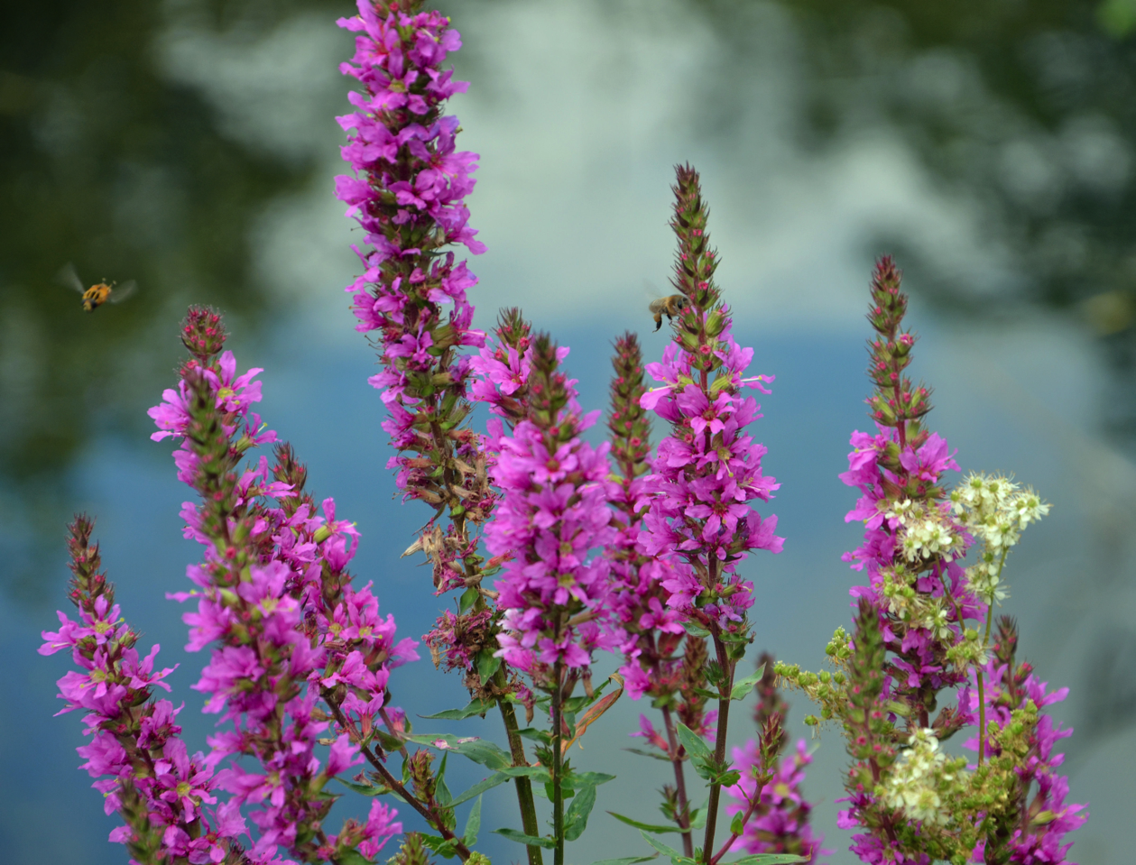
Impact on Native Species: The plant forms thick mats of roots degrading habitat for birds, insects, and other species
Interesting Fact: Each plant can grow up to 30 flowering stems producing 2.7 million seeds
Purple Loosestrife
Native Area: Wetland plant native to Europe and Asia
Where Found Now: All continental states except Florida
How Did They Get There: Seeds were included in soil used as ballast in saling ships
Notes:
Encyclopedia of Life. Available from http://www.eol.org. Accessed 23 Mar 2015. Purple Loosestrife: Encyclopedia of Life / Wikimedia Commons / Duncan Harris
Blossey, Bernd. "Purple Loosestrife." Purple Loosestrife. Cornell University, 2002. Web. 16 Sept. 2015. <http://www.invasiveplants.net/plants/purpleloosestrife.htm>.

Slide 6
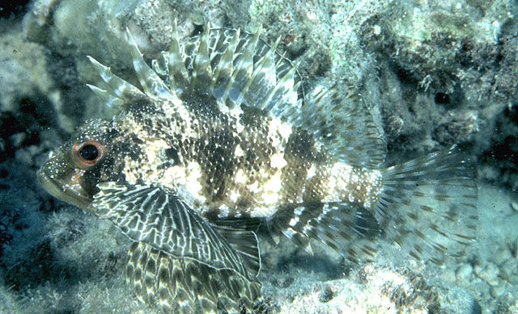
Lionfish
Impact on Native Species: Preys on native species; has venomous spines
Interesting Fact: Scientists have launched an “Eat Lionfish” Campaign to help control this invasive species
Native Area: Western Pacific Ocean
Where Found Now: Coastal waters of the SE United States and the Caribbean
How Did They Get There: Aquarium Trade
Notes:
Encyclopedia of Life. Available from http://www.eol.org. Accessed 23 Mar 2015. Lionfish: Encyclopedia of Life / FishBase/ © John E. Randall
"Invasive Species: Aquatic Species - Lionfish (Pterois Volitans)." Invasive Species: Aquatic Species - Lionfish (Pterois Volitans). US Department of Agriculture, 26 Sept. 2015. Web. 26 Sept. 2015. <http://www.invasivespeciesinfo.gov/aquatics/lionfish.shtml>.

Slide 7
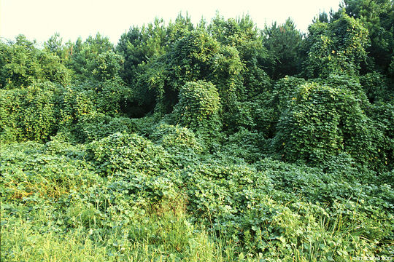
Kudzu
Impact on Native Species: Fast growing vine smothering other plants. Kudzu can kill mature trees.
Interesting Fact: During summer months, kudzu can grow up to 26cm (approximately 1 foot) in a single day.
Native Area: Eastern Asia and some Pacific Islands
Where Found Now: North America and Europe
How Did They Get There: Ornamental plant and for eating
Notes:
Encyclopedia of Life. Available from http://www.eol.org. Accessed 23 Mar 2015. Kudzu: Encyclopedia of Life / CalPhotos / © Barry Rice
"The Amazing Story of Kudzu." Max Shores. University of Alabama, 29 May 2013. Web. 26 Sept. 2015. <http://maxshores.com/the-amazing-story-of-kudzu/>.

Slide 8
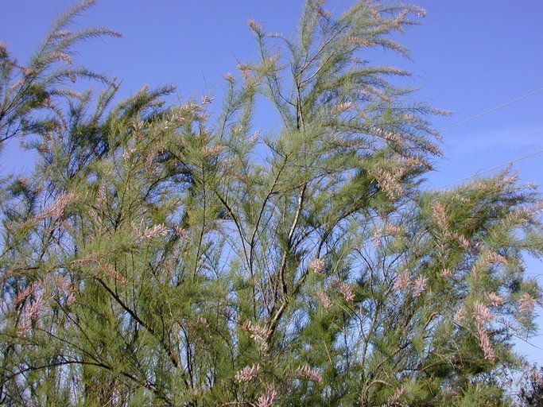
Tamarisk or Salt Cedar
Impact on Native Species: Outcompetes and replaces native species with long tap roots disrupting natural aquatic systems
Interesting Fact: The foliage and flowers provide little food value for wildlife
Native Area: Temperate and tropical Asia
Where Found Now: Southern United States
How Did They Get There: Planted as an ornamental and escaped cultivation
Notes:
Encyclopedia of Life. Available from http://www.eol.org. Accessed 23 Mar 2015. Tamarisk: Encyclopedia of Life / CalPhotos / © 2010 Steven Thorsted
"TexasInvasives.org - Home." Texas Invasives. N.p., 8 Nov. 2007. Web. 26 Sept. 2015. <http://www.texasinvasives.org/plant_database/detail.php?symbol=TARA>.

Slide 9
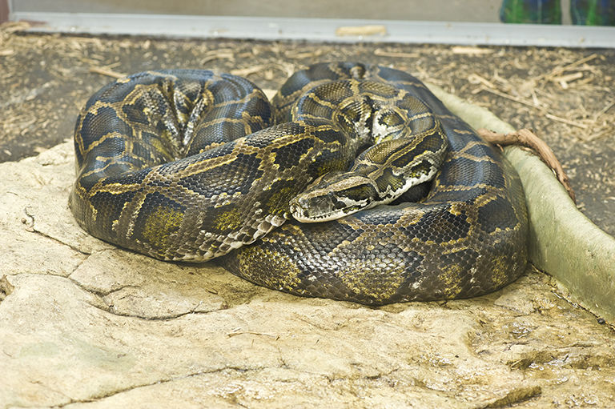
Burmese Python
Impact on Native Species: They reduce populations of native species and have few predators
Interesting Fact: One of the largest snakes in the world. The largest captured in Florida was over 17 feet in length
Native Area: Southeast Asia
Where Found Now: South Florida
How Did They Get There: Imported for the pet trade and escaped / intentionally released into the wild
Notes:
Encyclopedia of Life. Available from http://www.eol.org. Accessed 23 Mar 2015. Burmese Python: Encyclopedia of Life / CalPhotos / © 2013 California Academy of Sciences
"Nonnatives - Burmese Python." Nonnatives - Burmese Python. Florida Fish and Wildlife Conservation Commission, n.d. Web. 22 Sept. 2015. <http://myfwc.com/wildlifehabitats/nonnatives/reptiles/burmese-python/>.

Slide 10
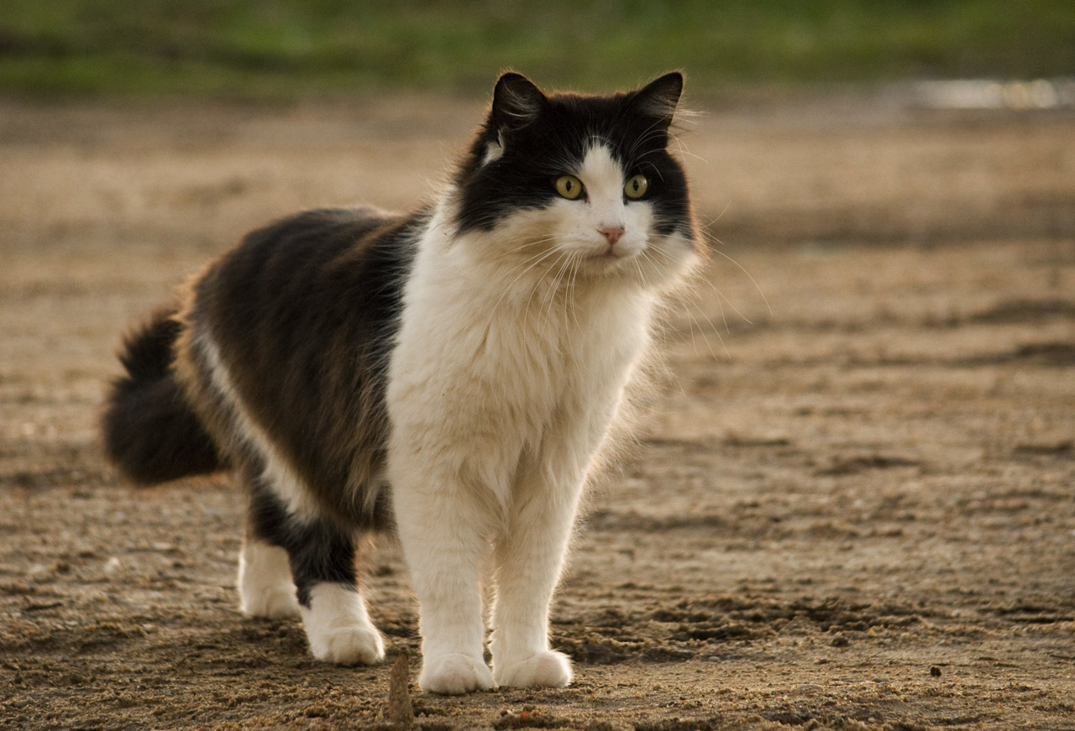
Feral Cats
Impact on Native Species: Decrease native wildlife abundance and diversity (especially species that nest near or on the ground)
Interesting Fact: A single female cat can produce up to 3 litters a year with 2-4 kittens per litter
Native Area: Originally bred from wild cats in the Near East; Domestic cats have no native range
Where Found Now: In all areas , they are not socialized to humans and live entirely outdoors
How Did They Get There: Domestic cats that have become feral
Notes:
Encyclopedia of Life. Available from http://www.eol.org. Accessed 23 Mar 2015. Cat: Encyclopedia of Life / iNaturalist.org / © Nicolas Olejnik
Bies, Laura, ed. "Feral Cats: Impacts of an Invasive Species." Feral Cats: Impacts of an Invasive Species (n.d.): n. pag. The Wildlife Society. Web. 26 Sept. 2015. <http://abcbirds.org/wp-content/uploads/2015/06/Fact-Sheet-2014-Feral-Cats-Impacts-of-an-invasive-species.pdf>.

Slide 11
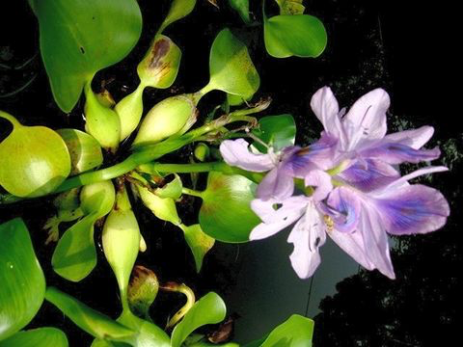
Water Hyacinth
Impact on Native Species: Fast growing plant that clogs up rivers
Interesting Fact: Change ecosystems by blocking sunlight to other plants below the surface
Native Area: Waterways of South America
Where Found Now: Southern United States and many subtropical and tropical climates
How Did They Get There: Decorative plants, aquarium trade, attached to boats
Notes:
Encyclopedia of Life. Available from http://www.eol.org. Accessed 23 Mar 2015. Water Hyacinth: Encyclopedia of Life / Flickr: EOL Images / © Ahmad Fuad Morad
"Harmful Aquatic Hitchhikers: Plants: Water Hyacinth." Harmful Aquatic Hitchhikers: Plants: Water Hyacinth. US Fish and Wildlife Service, n.d. Web. 26 Sept. 2015. <http://www.protectyourwaters.net/hitchhikers/plants_water_hyacinth.php>.

